Slide 1
Welcome
CS 472/572
Unsupervised Machine Learning
Clustering 2
Week-3 -Class -1
Spring 2026
Instructor: Dr. Khondker Fariha Hossain

Slide 2
Why a probabilistic approach?

Slide 3
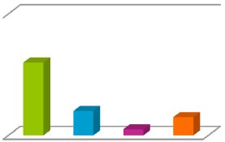
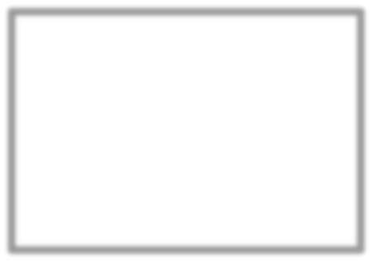





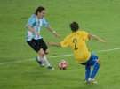


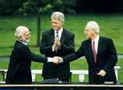



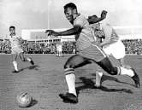
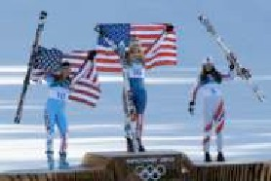


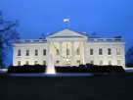





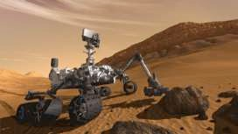
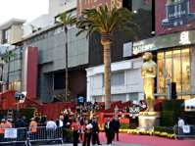



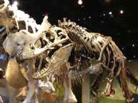
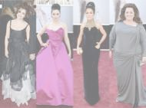
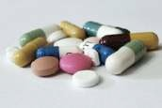




Learn user preferences
Set of clustered documents read by user
Cluster 1
Cluster 2
Use feedback to learn user preferences over topics
Cluster 3

Slide 4
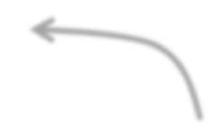



Uncertainty in cluster assignments
Cluster 1
Cluster 2
Slightly closer to Cluster 4 than Cluster 2, but count fully for Cluster 4?
Cluster 3

Slide 5
Uncertainty in cluster assignments
Cluster 1
Cluster 2
Hard assignments don’t tell full story
Cluster 3

Slide 6
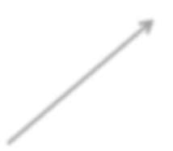







Other limitations of k-means
Assign observations to closest cluster center
z_{i} ← arg min ||µ_{j} — x_{i}||²
j
2
Can use weighted Euclidean, but requires known weights
Only center matters
Still assumes all clusters have the same axis-aligned ellipses
Equivalent to assuming spherically symmetric clusters

Slide 7
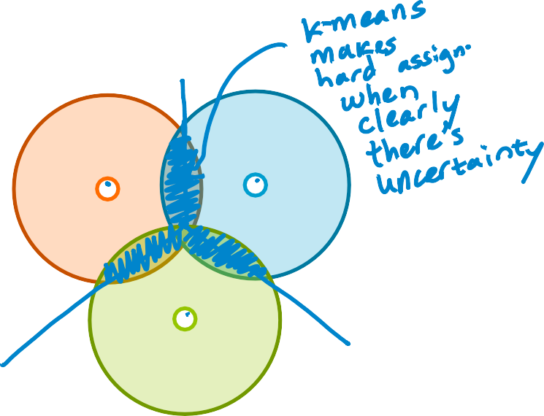



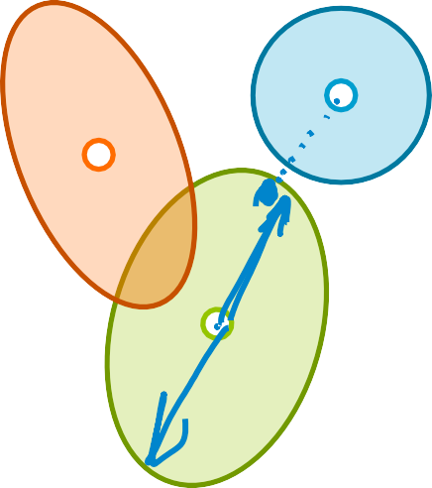
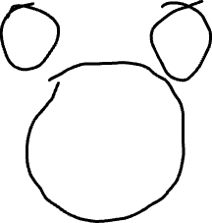


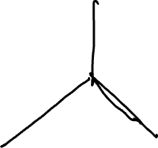





Failure modes of k-means
overlapping clusters
disparate cluster sizes
different shaped/ oriented clusters

Slide 8
Motivates probabilistic model:
mixture model
Provides soft assignments of observations to clusters (uncertainty in assignment)
e.g., 54% chance document is world news, 45% science, 1% sports, and 0% entertainment
Accounts for cluster shapes not just centers
Enables learning weightings of dimensions
e.g., how much to weight each word in the vocabulary when computing cluster assignment

Slide 9
Mixture models

Slide 10
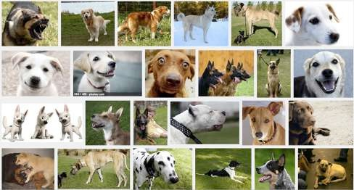
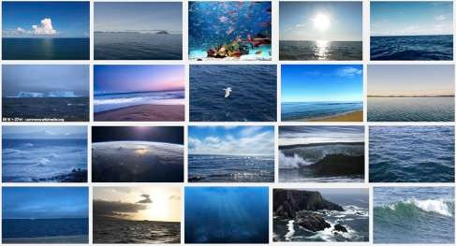
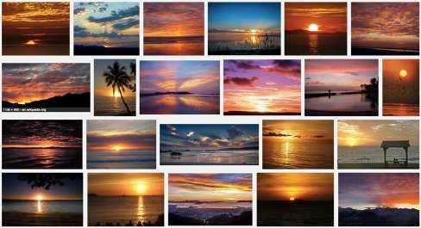
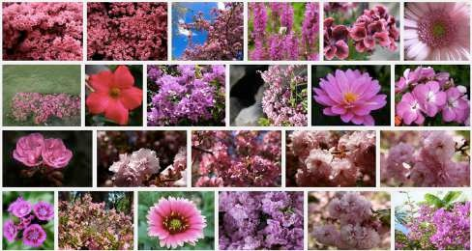
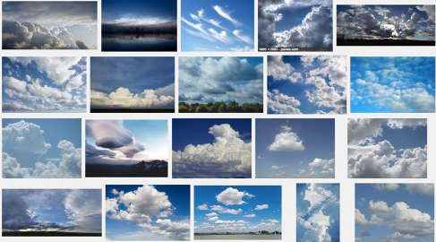
Motivating application: Clustering images
Discover groups of similar images
- Ocean
Pink flower
Dog
Sunset
Clouds
- …
Provide groupings but not category names

Slide 11
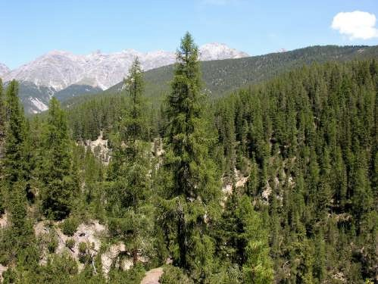
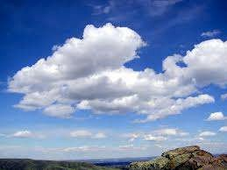

Simple image representation
Consider average red, green, blue pixel intensities
[R = 0.05, G = 0.7, B = 0.9]
[R = 0.02, G = 0.95, B = 0.4]
[R = 0.85, G = 0.05, B = 0.35]

Slide 12
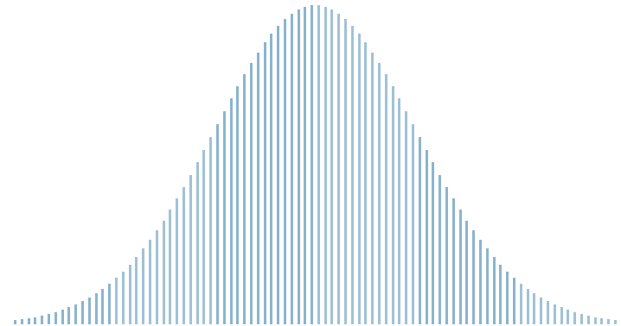


Distribution over all cloud images
Let’s look at just the blue dimension
0.8
blue

Slide 13
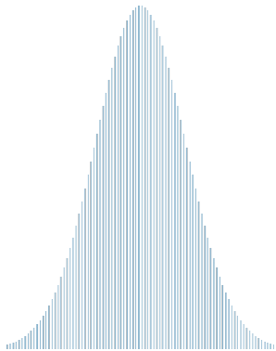

Distribution over all sunset images
Let’s look at just the blue dimension
0.3
blue

Slide 14
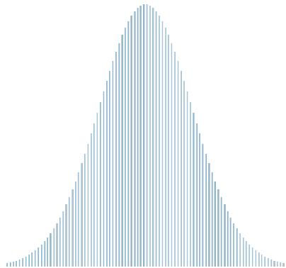

Distribution over all forest images
Let’s look at just the blue dimension
0.3
blue

Slide 15
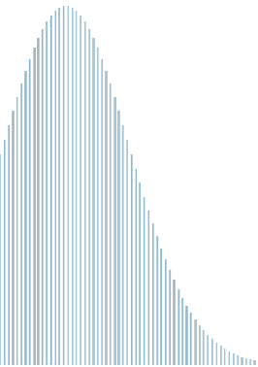
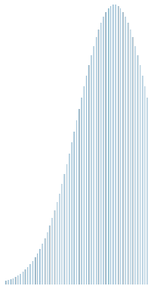

Distribution over all images
blue

Slide 16
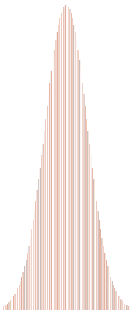
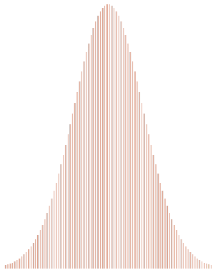


Can be distinguished along other dim
Now look at the red dimension
0.05
0.9
red

Slide 17
Background:
Gaussian distributions

Slide 18
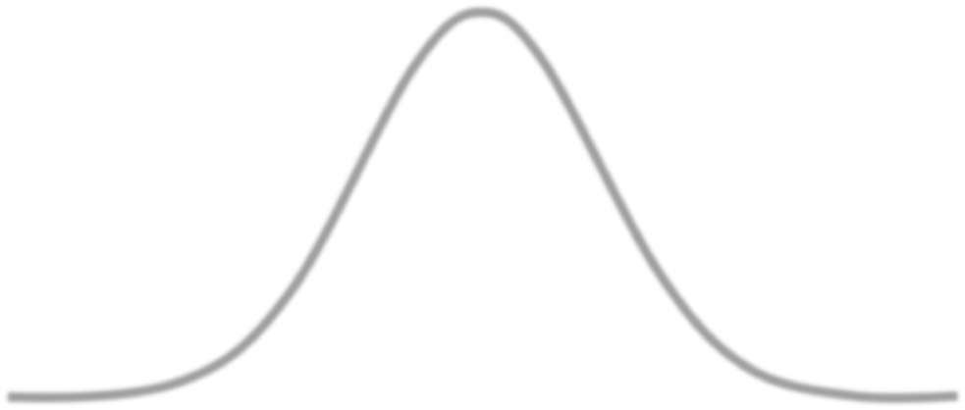

Model for a given image type
For each dimension of the [R, G, B] vector, and each image type, assume a
Gaussian distribution over color intensity
0.8

Slide 19
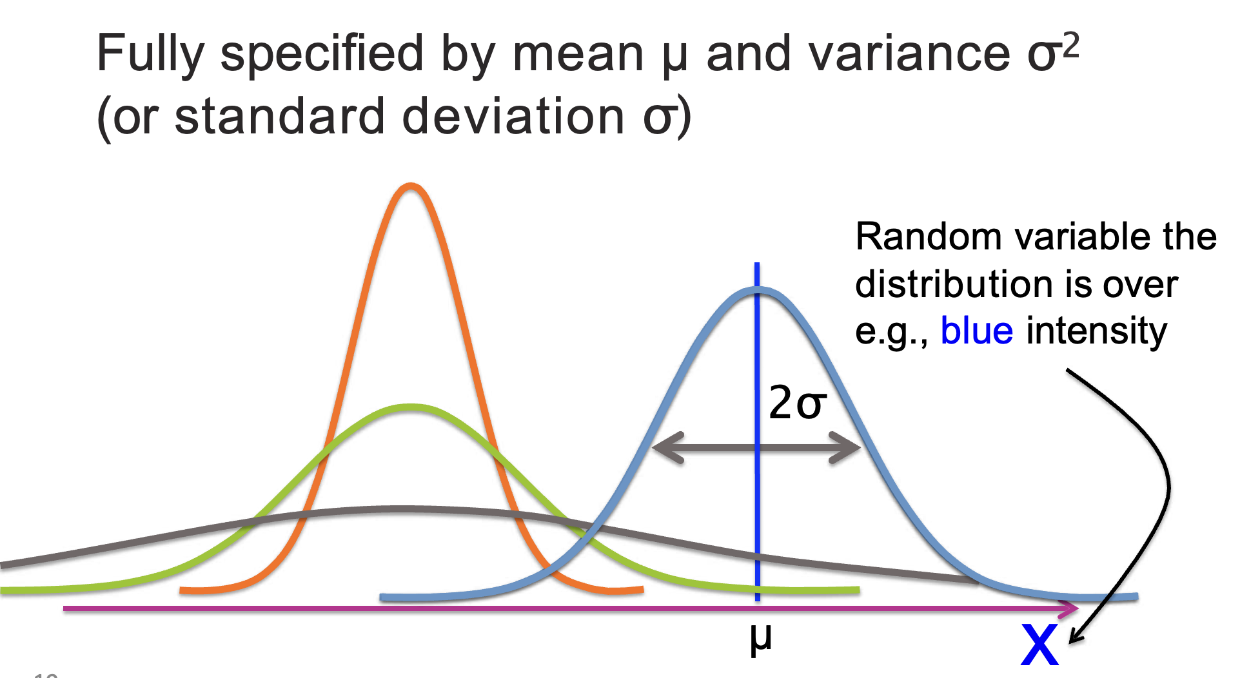
1D Gaussians

Slide 20
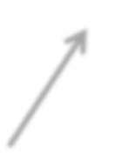


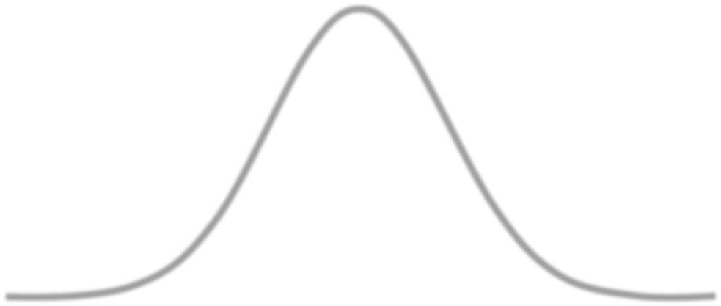
Notating a 1D Gaussian distribution
N(x | µ, σ²)
parameters
Random variable the distribution is over e.g., blue intensity
2σ
µ
x

Slide 21
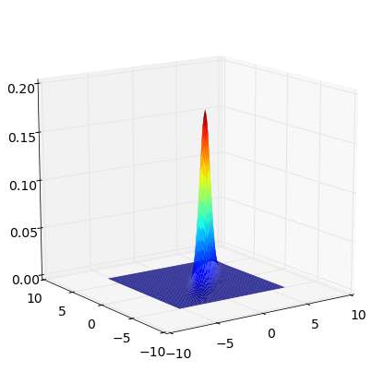
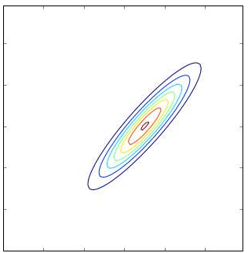


2D Gaussians – Bird’s eye view
3D mesh plot Contour plot
probability
green
blue
blue

Slide 22
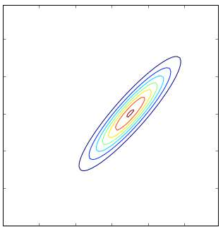
2D Gaussians – Parameters
Fully specified by mean µ and covariance Σ
^{µ = [µ}blue ^{, µ}green]
mean centers the distribution in 2D
green
µ[2]
µ[1]
blue

Slide 23



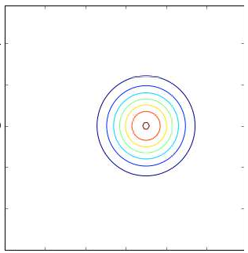
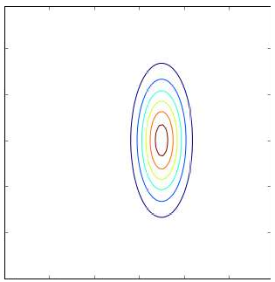
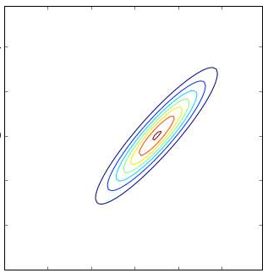
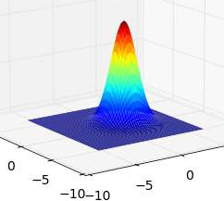
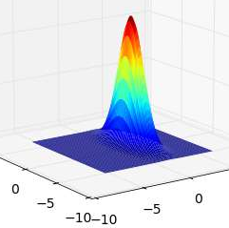
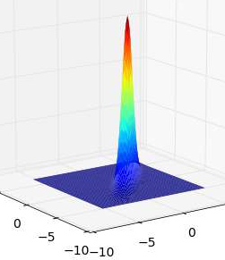
Covariance structures
0
_{σ}2
Σ = ^{σB}
2
0
_{σG}2
Σ = ^{σB}
2
^{σ}G,B
^{σ}B,G
_{σG}2
Σ = ^{σ2}
0
0

Slide 24
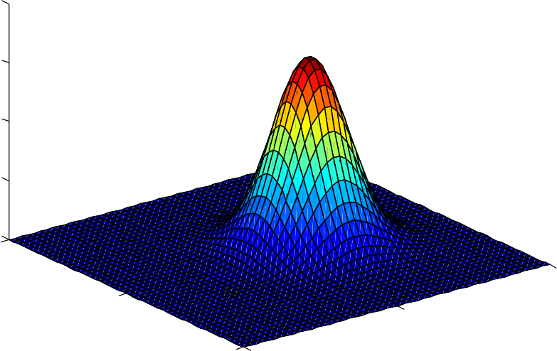
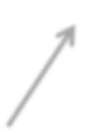


Notating a multivariate Gaussian
N(x | µ, Σ)
parameters Random vector
e.g., [R, G, B] intensities
0.2
0.15
0.1
0.05
0
5
5
0
0
−5
−5

Slide 25
Mixture of Gaussians

Slide 26
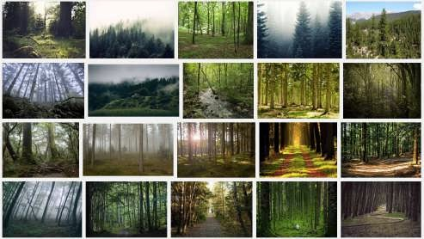
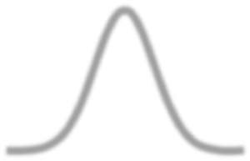

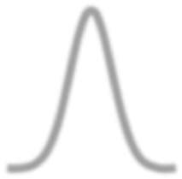


Model as Gaussian per category/cluster
0.42
blue
0.3
blue
0.8

Slide 27


































Jumble of unlabeled images
HISTOGRAM
blue
How do we model this distribution?

Slide 28
Model of jumble of unlabeled images
0.42
blue
0.3
blue
0.8

Slide 29










What if image types not equally represented?
e.g., forest images are very likely in the collection
0.30.42
0.8
blue

Slide 30
















Combination of weighted Gaussians
Associate a weight π_{k} with each Gaussian component
π₁ π₂ π₃
π = [0.47 0.26 0.27]
π
1
Relative proportion of each class in world from which we get data
π
π₃
2

Slide 31

Combination of weighted Gaussians
Associate a weight π_{k} with each Gaussian component
π₁ π₂ π₃
π = [0.47 0.26 0.27]
π
1
0 ≤ π_{k} ≤ 1
π_{k} = 1
π₂
π₃
x

Slide 32









Mixture of Gaussians (1D)
Each mixture component represents a unique cluster specified by:
{π_{k} , μ_{k} , σ_{k} }
2
π₁
σ₁
π₃
π₂
σ₂
σ₃
μ₂
μ₁
μ₃
x

Slide 33










Mixture of Gaussians (general)
Each mixture component represents a unique cluster specified by:
{π_{k} , μ_{k} , Σ_{k} }
μ₁,Σ₁
π₁
π₃
π₂
μ₃,Σ₃
μ₂,Σ₂

Slide 34













According to the model…
Without observing the image content, what’s the probability it’s from cluster k? (e.g., prob. of seeing “clouds” image)
p(z_{i} = k) = ⇡_{k}
Given observation x_{i} is from cluster k, what’s the likelihood of seeing x_{i}? (e.g., just look at distribution for “clouds”)
p(x_{i} | z_{i} = k, µ_{k}, ⌃_{k}) = N(x_{i}|µ_{k}, ⌃_{k})
π₁
π₂
π₃
x

Slide 35
Thank you
This content includes adaptations from instructional materials originally created by Emily Fox and Carlos Guestrin for the University of Washington’s Machine Learning Specialization on Coursera. All rights reserved by the original authors.

